Slide 1
NΞXT GΞN PΞN TΞST
INTRODUCTION TO RED TEAMING AND ADVERSARY EMULATION
Notes:
WELCOME TO “NEXT GEN PEN TEST - INTRODUCTION TO RED TEAMING AND ADVERSARY EMULATION”
THE NEXT HALF-HOUR IS GOING TO BE A HIGH LEVEL OVERVIEW OF A QUITE TECHNICAL NICHE OF INFORMATION SECURITY
WE WILL HAVE A LOOK AT HOW - NOWADAYS - THE BAD GUYS TAKE ADVANTAGE OF THE WEB TO DO THEIR THING AND WIL WILL TRY TO COME UP ON THE OTHER SIDE WITH A STRATEGY ON HOW TO DEFEND FROM THEM

Slide 2
QUICK PREFACE
SLIDES WILL BE SHARED
MEME’S WILL BE USED
I LOVE BEING INTERRUPTED WITH QUESTIONS!
Notes:
SLIDES WILL BE SHARED AFTER THIS TALK, INCLUDING SPEAKER’S NOTES (BTW A BIG SHOUT OUT TO BLABLA FOR SUPPORTING THE IDEA OF THIS BLABLABLA AND TO BLABLABLABLA FOR HIS/HER HELP IN SETTING IT UP!)
EARLY WARNING: HOPE YOU ALL HAVE NOTHING AGAINST MEME’S…
LASTLY, LET’S KEEP THIS INTERACTIVE! DON’T WAIT FOR THE END TO ASK QUESTIONS

Slide 3
WHAT THIS IS
WHAT THIS IS NOT
VERY (VERY) FAST OVERVIEW
I WILL (OVER) SIMPLIFY
SOME TOOL MENTIONED
SOME STORIES TOLD
100% COMPREHENSIVE
A HOW-TO GUIDE
PERFECT ATTRIBUTION
Notes:
SO, A LITTLE BIT MORE ON TODAY’S PRESENTATION
WE’LL GO PRETTY QUICKLY OVER SOME BIG TOPICS
SO THERE WILL BE SIMPLIFICATIONS MADE…
I WILL MENTION SOME TOOLS AND WILL ALSO PUT ALL THE REFERENCES AT THE END
AND WE WILL ALSO TOUCH UPON SOME OF THE MOST FAMOUS STORIES OF BREACHES AND COMPROMISES IN THE HISTORY OF THE WEB
THIS OF TODAY, IS DEFINITELY NOT GOING TO BE A BE ALL AND ALL GUIDE TO ADVERSARY EMULATION OR A HOW-TO GUIDE TO ANY TOOL, BUT I’D LIKE TO SHOW YOU THE TOPIC AND HOPEFULLY ENTERTAIN YOU A BIT DURING THE NEXT HALF-HOUR

Slide 4

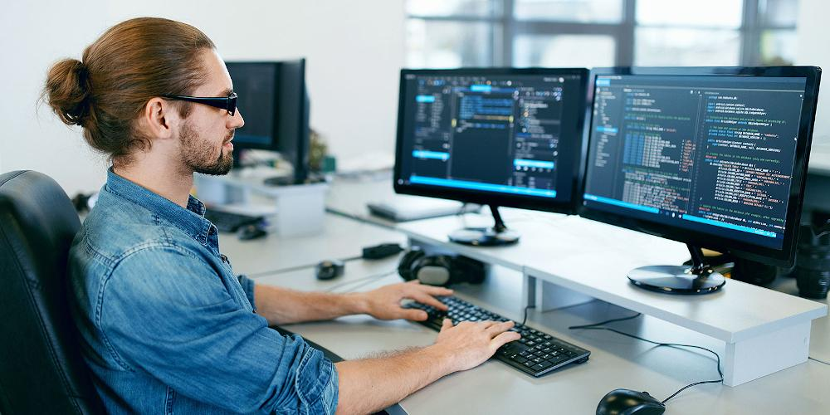
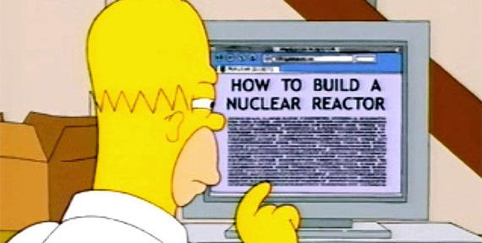

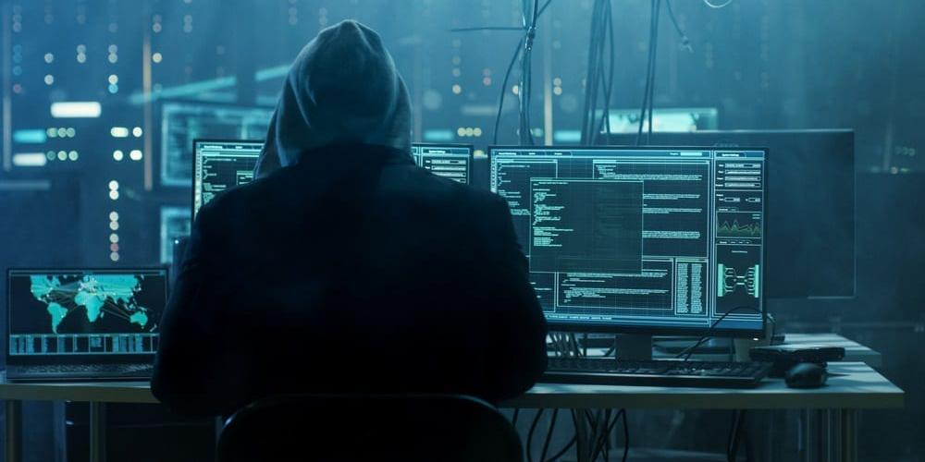
WHOAMI
Notes:
OK, SO LET’S START FROM WHO I AM.
HERE IS TO MY STORY…
IN TERMS OF SPARKPOST LIFE, I JOINED YOU ALL AT THE BEGINNING OF THIS MONTH AND I WORK WITH JEANNIE AND JIM IN THE “SEC” TEAM
MORE ABOUT ME… BIO ENGINEER BY EDUCATION, SOFTWARE DEVELOPER (AND MULTICOLORED HAT HACKER) BY VOCATION
WELL, THE 3RD PICTURE IS ACTUALLY NOT VERY ACCURATE… THIS IS MORE REALISTIC REPRESENTATION OF MY SCIENTIFIC METHOD...

Slide 5
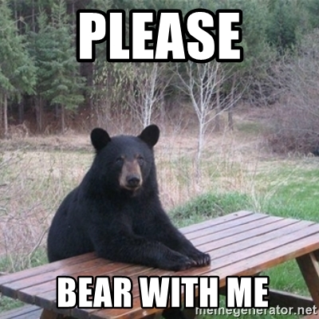
DISCLAIMER
Notes:
ALSO, BIG DISCLAIMER: THIS HAS NEVER BEEN PART OF ANY OF MY DAY JOBS. INFACT, THE REALITY IS THAT, I SIMPLY LOVE THE TOPIC! SO… PLEASE BEAR WITH ME :)
AND, LIKE I LOVE SAYING, I AM TODAY THE BEST VERSION OF MY OLD SELF, BUT ONLY THE WORST VERSION OF MY FUTURE SELF

Slide 6
LET’S GET (MORE) SERIOUS

Slide 7
THE CYBER ATTACK CHAIN
RECON
POST-ACCESS
BUSINESS VALUE
ACCESS
Notes:
IF WE TAKE A LOOK AT THE CYBER ATTACK CHAIN, TRADITIONALLY, OFFENSIVE SECURITY’S FOCUS HAS BEEN MORE ON GETTING ACCESS TO THE TARGET ENVIRONMENT, THAN ON WHAT TO DO ONCE ACCESS IS OBTAINED
BUT WHAT HAPPEN AFTER THE MALICIOUS ACTOR GETS ACCESS?
- INTELLECTUAL PROPERTY STOLEN?
- CUSTOMERS/EMPLOYEES PERSONAL IDENTIFIABLE INFORMATION STOLEN?
- COMPANY REPUTATION RUINED?
- MONETARY IMPACT (COST OF COMPROMISE)?
THESE ARE ALL POSSIBLE CONSEQUENCES OF A CYBER ATTACK AND, OF COURSE, THE BUSINESS VALUE OF A SECURITY ASSESSMENT IS HIGHER THE MORE WE SPEND TIME TRYING TO UNDERSTAND HOW ATTACKERS BEHAVE ONCE THEY ARE INSIDE A NETWORK (THE “ASSUMED-BREACH“ APPROACH, MORE ON THIS LATER)

Slide 8






THE EVOLUTION OF OFFENSIVE SECURITY
VULN
SCANNING
VULN
ASSESSMENT
PENETRATION
TESTING
RED
TEAMING
PURPLE
TEAMING
ADVERSARY
EMULATION
Notes:
ANOTHER WAY OF LOOKING AT THIS PROBLEM, IS TO CONSIDER HOW SECURITY TESTING OF IT INFRASTRUCTURE EVOLVED IN THE RECENT YEARS
ALL THE WAY FROM SCANNING FOR KNOWN VULNERABILITIES, ASSESSING THEIR LIKELIHOOD OF BEING LEVERAGED BY ATTACKERS (VULN ASSESSMENT), TRYING TO WEAPONIZE THEM INTO EXPLOITS (TRADITIONAL PENTESTING), TO THE POINT WHERE THE OFFENSIVE TESTERS STARTS TO ACT FROM THE PERSPECTIVE OF REAL ATTACKERS, WITH REAL AND VERY PRECISE MOTIVES AND TARGETS (RED TEAMING)
RED TEAMING IS NOTHING NEW AND IT HAS BEEN AROUND FOR YEARS, BUT ONLY RECENTLY HAS BECOME A MORE AND MORE POPULAR AND VALUED MODEL FOR SECURITY ASSESSMENTS.
THE SAME WAY, VULNERABILITY SCANNING AND MANAGEMENT HAS DEFINITELY NOT GONE AWAY, IT IS STILL VERY VERY IMPORTANT AND A FUNDAMENTAL BUILDING BLOCK OF ANY SOLID CYBERSECURITY POSTURE.
PURPLE TEAMING IS….
AND THEN WHEN, AS AN ORGANIZATION, YOU THINK YOU HAVE DONE A GREAT JOB OF BUILDING BLUE AND RED TEAMS AND AT MAKING THEM WORK TOGETHER, YOU UNDERSTAND THAT NOWADAYS THE TOOLS, PRODUCT AND PLATFORMS AVAILABLE TO DEFEND YOURSELF ARE SUCH DOING A GREAT JOB AT TAKING LOW-TO-AVERAGE COMMITTED ACTORS OUT OF THE PLAY, THAT THE REAL THREAT COMES PRIMARILY FROM ORGANIZED CYBER CRIME AND NATION SPONSORED ACTORS.
SO: HOW THE HELL DO YOU LEARN HOW TO DEFEND FROM THESE?!? WITH ADVERSARY EMULATION EXERCISES OF COURSE!

Slide 9
PENTESTING vs RED TEAMING vs ADVERSARY
EMULATION
PRIMARILY SEEKS TO IDENTIFY OPPORTUNITIES OF COMPROMISE
TRADITIONALLY RUN WITH LESS TO VERY LITTLE FOCUS ON POST EXPLOITATION
USUALLY SUFFICIENT TO SATISFY COMPLIANCE REQUIREMENTS
PRIMARILY SEEKS TO IDENTIFY OPPORTUNITIES OF COMPROMISE
TRADITIONALLY RUN WITH LESS TO VERY LITTLE FOCUS ON POST EXPLOITATION
USUALLY SUFFICIENT TO SATISFY COMPLIANCE REQUIREMENTS
TESTS AND MEASURES PEOPLE, PROCESSES AND TECHNOLOGY
RED TEAM OPERATIONS HAVE NARROWED OBJECTIVES AND A SIMULTANEOUS APPROACH
MAKES THE BLUE TEAM BETTER (W/ PURPLE TEAMING EXERCISES)
TESTS AND MEASURES PEOPLE, PROCESSES AND TECHNOLOGY
RED TEAM OPERATIONS HAVE NARROWED OBJECTIVES AND A SIMULTANEOUS APPROACH
MAKES THE BLUE TEAM BETTER (W/ PURPLE TEAMING EXERCISES)
EMULATES AN ADVERSARY ATTACK CHAIN OR SCENARIO
ALLOWS TO UNDERSTAND THE ORGANIZATION’S PREPAREDNESS IF UNDER A REAL, SOPHISTICATED ATTACK
IT IS MANUAL, RESOURCE INTENSIVE AND IMPACTS THE ENTIRE ORGANIZATION
EMULATES AN ADVERSARY ATTACK CHAIN OR SCENARIO
ALLOWS TO UNDERSTAND THE ORGANIZATION’S PREPAREDNESS IF UNDER A REAL, SOPHISTICATED ATTACK
IT IS MANUAL, RESOURCE INTENSIVE AND IMPACTS THE ENTIRE ORGANIZATION
Notes:
LET’S TRY TO COME UP WITH SOME DEFINITIONS:
[ READ THE SLIDE ]
SECURITY POSTURE / CHECKING BOXES (THE CUSTOMER IS THE C-LEVEL)
VS. DATA EXFILTRATION / BUSINESS COMPROMISE (THE CUSTOMER IS THE BLUE TEAM)
VS. SIMULATION OF ATTACKS FROM APTs (CUSTOMERS ARE BOTH MGMT AND THE BLUE TEAM)

Slide 10
WHY BOTHER?
Notes:
SO, WHY BOTHER AT ALL ABOUT RED TEAMING AND ADVERSARY EMULATION/

Slide 11
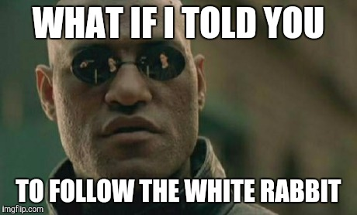
THESE ARE MY 3 ANSWERS TO WHY BOTHER
YOURS MAY BE DIFFERENT!
TECH
GEOPOLITICS
GEOECONOMICS
Notes:
FIRST OF ALL, THE TECH! THE TOOLS INVOLVED, MOST OF THE TIMES ARE “CUTTING EDGE STUFF”
BUT THEN, AND MAYBE EVEN MORE INTERESTING, IS DEEP DIVING INTO THE IMPACTS THAT CYBER CRIME AND STATE-SPONSORED HACKING HAVE ON GEOPOLITICS AND GEOECONOMICS! (MORE ON THAT LATER)

Slide 12
THIS IS THE TECH WE NEED
ATTACK FRAMEWORK
……………………..……...…..……….(MITRE ATT&CK)
ATTACK INFRASTRUCTURE
……………..….……….…..….………..(CALDERA)
GOVERNANCE AND TRACKING TOOL
…....…………….…….……..(VECTR)
A WAY TO TEST DEFENSES
……………….…....…....(ATOMIC RED TEAM)
Notes:
SO, WHAT TO WE ACTUALLY NEED TO PERFORM AN ADVERSARY EMULATION EXERCISE?
WELL, THERE ARE MANY MANY DIFFERENT WAYS TO GO AFTER IT, BUT THIS IS THE STACK I FOCUSED MYSELF ONTO:
WE NEED AN “ATTACK FRAMEWORK”: THINK ABOUT ATT&CK AS OUR CONFLUENCE
WE NEED AN “ATTACK INFRASTRUCTURE”: AT CALDERA AS OUR SDLC AND RUNTIME
WE NEED A WAY TO ORGANIZE AND COORDINATE THE WORK OF ALL THE PEOPLE AND TEAMS INVOLVED: THINK ABOUT AT VECTR AS OUR JIRA
AND FINALLY WE NEED A WAY TO TEST THE DEFENSES THAT WE PUT IN PLACE BASED ON THE FINDINGS OF THE ADVERSARY EMULATION EXERCISE: THINK AT ATOMIC RED TEAM AS OUR QA POLICIES AND TEST FRAMEWORKS
WE WON’T HAVE THE TIME TO LOOK AT THESE TOOLS ONE-BY-ONE TODAY, BUT I WILL PROVIDE LINKS TO ALL OF THEM AT THE END
FOR NOW, WE WILL PRIMARILY FOCUS ON THE ATTACK FRAMEWORK

Slide 13
THE FRAMEWORK
Notes:
MITRE ATT&CK

Slide 14
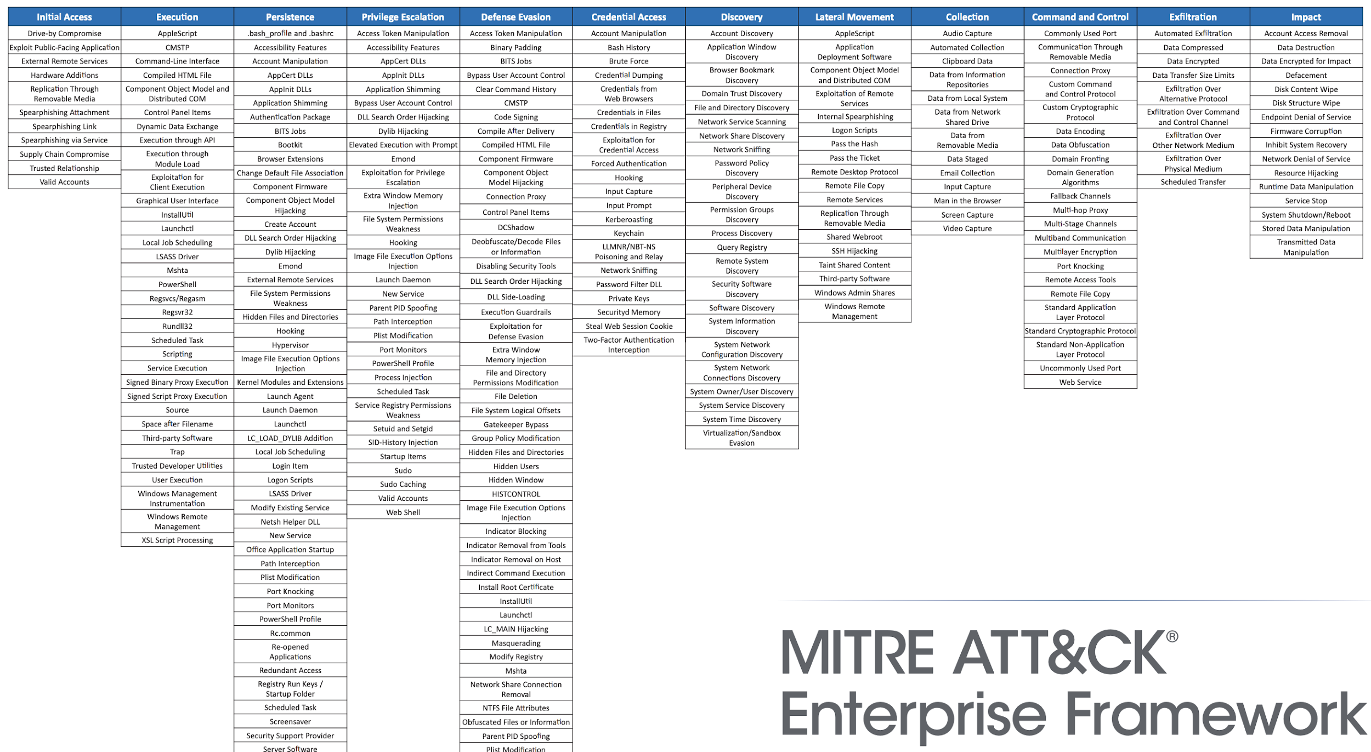
MITRE ATT&CK
WHAT - A GLOBALLY ACCESSIBLE KNOWLEDGE BASE OF ADVERSARY TACTICS AND TECHNIQUES BASED ON REAL-WORLD OBSERVATIONS OF ATTACKER BEHAVIORS
WHAT - A GLOBALLY ACCESSIBLE KNOWLEDGE BASE OF ADVERSARY TACTICS AND TECHNIQUES BASED ON REAL-WORLD OBSERVATIONS OF ATTACKER BEHAVIORS
WHO - A NON-FOR-PROFIT AND FEDERALLY FUNDED RESEARCH CENTER
WHO - A NON-FOR-PROFIT AND FEDERALLY FUNDED RESEARCH CENTER
WHY - DEVELOP DETECTION CAPABILITIES FOR BLUE TEAMS AND CREATE ADVERSARY EMULATION PLAYBOOKS FOR RED TEAMS
WHY - DEVELOP DETECTION CAPABILITIES FOR BLUE TEAMS AND CREATE ADVERSARY EMULATION PLAYBOOKS FOR RED TEAMS
Notes:
[ READ THE SLIDE ]
TACTICS AND TECHNIQUES (COLUMNS AND ROWS)
THE BIGGEST BENEFIT OF ADOPTING AND EMBRACING ATT&CK IS THAT IT GIVES ALL THE TEAMS AND PEOPLE INVOLVED (ATTACKERS, DEFENDERS, MANAGEMENT, ...) A COMMON LANGUAGE AND A SHARED DICTIONARY
IT’S A GREAT FRAMEWORK AND THE RESULT OF A TREMENDOUS EFFORT FROM THE INFOSEC COMMUNITY AND I HIGHLY RECOMMEND YOU GIVE IT A LOOK

Slide 15
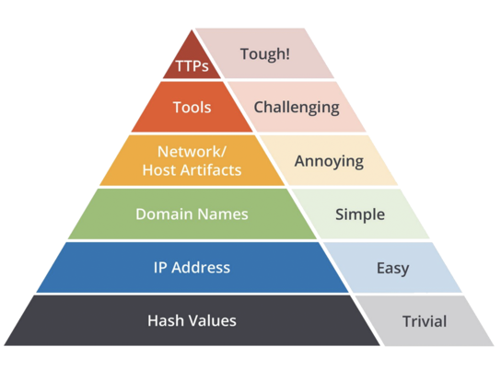
IOCs vs TTPs
INDICATORS OF COMPROMISE:
“ARTIFACT OBSERVED ON A NETWORK OR IN AN OPERATING SYSTEM THAT, WITH HIGH CONFIDENCE, INDICATES AN INTRUSION”
MOST COMMON:
- AV SIGNATURES
- HASHES
- FILE NAMES
- IPs
- URLs/DOMAINS
TACTICS, TECHNIQUES AND PROCEDURES:
EXPLAIN ADVERSARY BEHAVIOR
APPLICABLE IN DEVELOPING CONTEXTUAL UNDERSTANDING ACROSS INCIDENTS, CAMPAIGNS AND THREAT ACTORS (APTs)
EXAMPLE:
- TACTIC: INITIAL ACCESS
- TECHNIQUE: EXPLOIT
PUBLIC-FACING APPLICATION
- TACTIC: CREDENTIAL ACCESS
- TECHNIQUE: BRUTE FORCE
Notes:
THE BIG SHIFT IN MENTALITY, MOVING FROM TRADITIONAL PENTESTING TO RED TEAMING AND ADVERSARY EMULATION, INCLUDES THE SHIFT FROM WORKING WITH INDICATORS OF COMPROMISE TO WORKING WITH TECTICS, TECHNIQUES AND PROCEDURES.
FIRST OF ALL: WHAT IS AN INDICATOR OF COMPROMISE (OR IOC) AND WHAT ARE TTPS (AS DEFINED BY MITRE)?
IT’S IMPORTANT TO NOTICE THAT ALL THIS WORK IS BASED ON THE ASSUMPTION THAT THE ENDPOINT IS ALREADY COMPROMISED (THE ATTACKER HAS ALREADY INITIAL ACCESS -> “ASSUMED BREACH” CONCEPT) EITHER VIA SUCCESSFUL EXPLOIT(S) AND/OR SOCIAL ENGINEERING
THE FIGURE IN THE CENTER REPRESENTS THE PYRAMID OF PAIN WITH, FROM BOTTOM TO TOP:
HIGH DETECTION VOLUMES -> LOW DETECTION EFFORT -> LOW BUSINESS VALUE
ALL THE WAY TO:
LOW DETECTION VOLUME -> HIGH DETECTION EFFORT -> HIGH BUSINESS VALUE

Slide 16
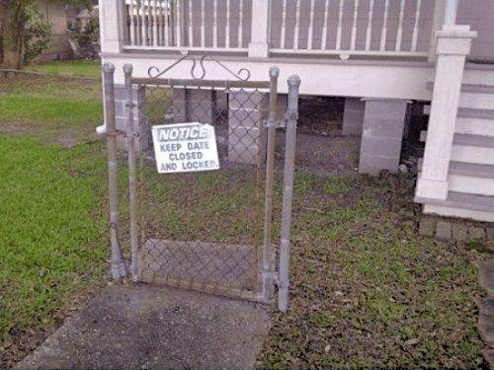
SEEKING BEHAVIORS, NOT SIGNATURES
T1124 -> “SYSTEM TIME DISCOVERY”
APT123v1:
$ net time \hostname
APT123v2:
$ powershell Get-Date
Notes:
HERE IS AN EXAMPLE OF HOW WE COULD MOVE FROM IOCs TO TTPS.
THIS MEANS THAT, IF YOU BUILD YOUR DETECTION RULES BASED ON SIGNATURES OF ANY OTHER KIND OF IOCS, SOONER OR LATER YOU WILL BE MISSING THE EVENTS YOU SHOULDN’T MISS (A FALSE NEGATIVE)
WHILE, IF YOU INSTEAD START WORKING WITH BEHAVIORS IN MIND, YOUR RULES WILL BE DRAMATICALLY MORE FLEXIBLE AND ABLE TO CATCH ALL DIFFERENT OCCURRENCES OF THE SAME MALICIOUS BEHAVIOR

Slide 17
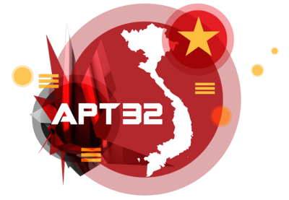
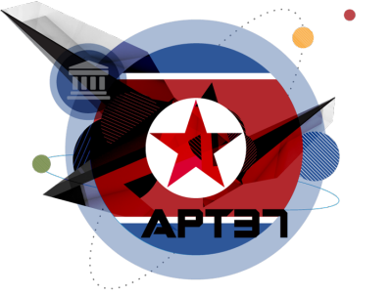
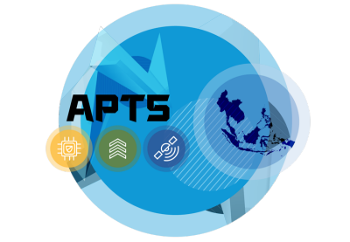
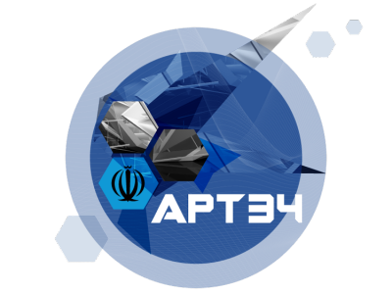
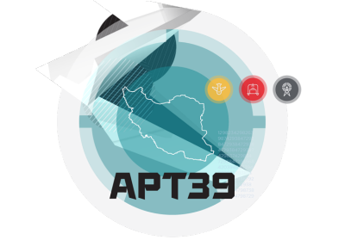


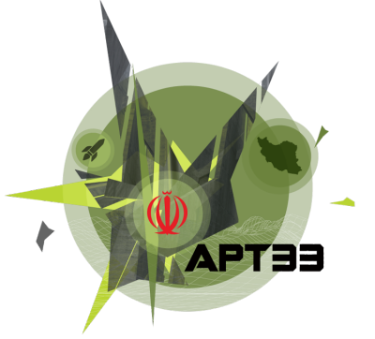
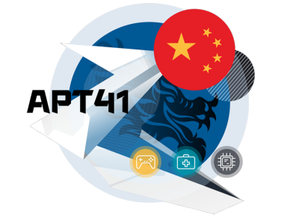
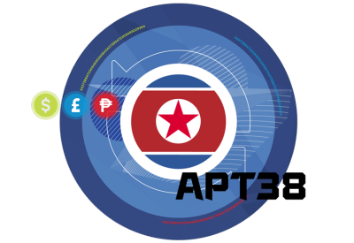

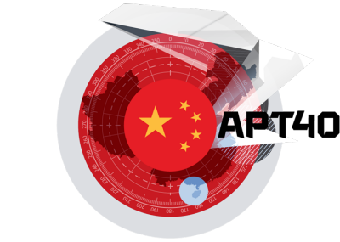

EXAMPLE OF ADVERSARIAL BEHAVIOR
Notes:
DEMO -> APT29 COZY BEAR TECHNIQUES USED
PLEASE LET ME KNOW IF I AM GOING TO FAST!

Slide 18
IT GOES BEYOND TECHNOLOGY
Notes:
LET’S TALK ABOUT WHERE TECH MEETS GEOPOLITICS AND GEOECONOMICS

Slide 19
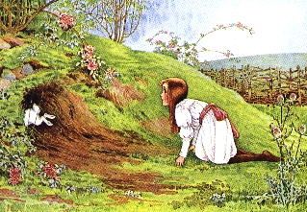
LET’S..

Slide 20
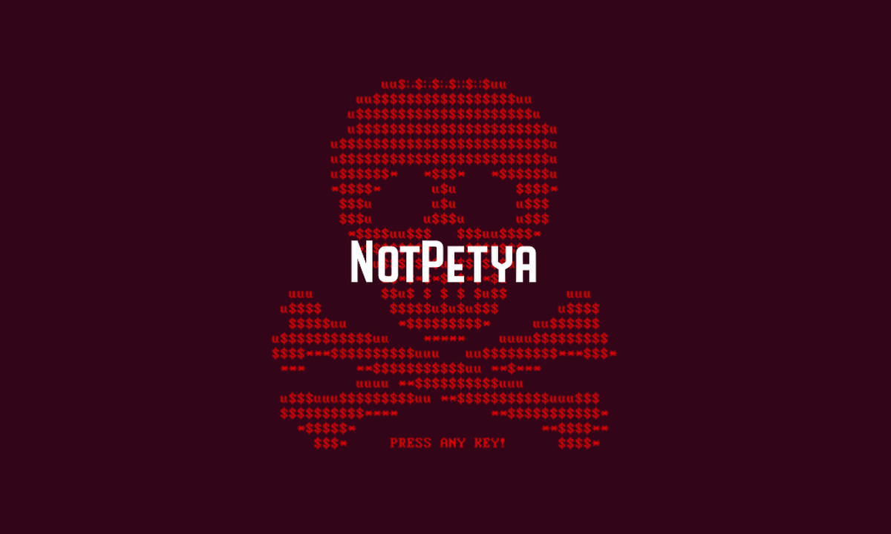
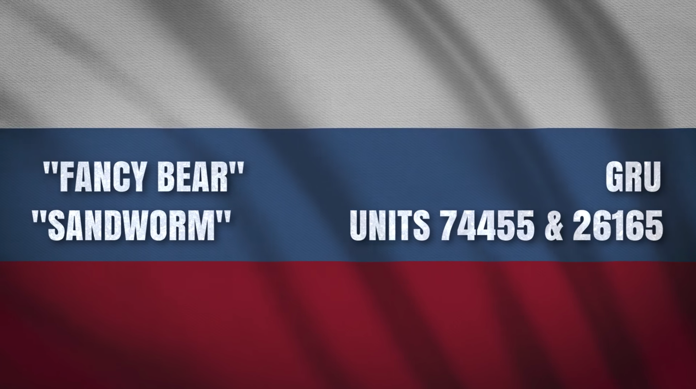

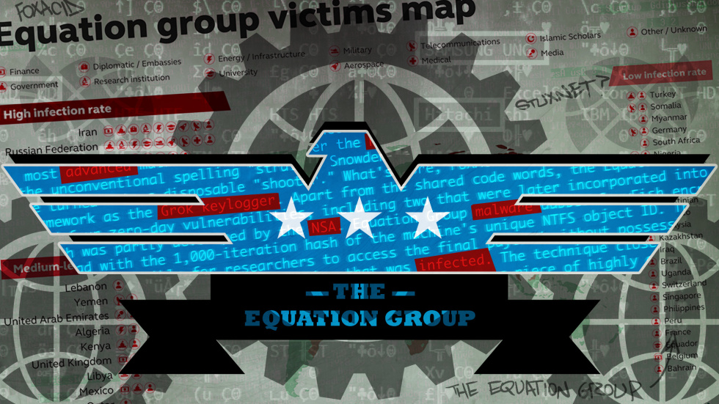

RABBIT HOLE #1: NOTPETYA
Notes:
SPRING 2017
TRUMP JUST ELECTED
RUSSIA/PUTIN INVADED CRIMEA IN ESCALATION AGAINST UKRAINE
[ NEXT ]
MIMIKATZ + ETERNALBLUE (SMB) TO OBTAIN ACCESS AND A NEW STRAIN OF PETYA AKA NOTPETYA (RANSOMWARE) FOR ENCRYPTING AND REBOOTING (WIPER, NOT A RANSOMWARE)
MEDOC BY LINKOS (ACCOUNTING SOFTWARE) INITIAL COMPROMISE
TARGET WAS THE ENTIRE COUNTRY OF UKRAINE (BANKS, PRIVATE COMPANIES, GOVERNMENT, POSTAL SERVICE, PENSION SYSTEM, TRANSPORTATION, ...)
BUT ALSO FEDEX, MAERSK, MONDELEZ AND MANY MANY OTHERS AS COLLATERAL DAMAGE
MAERSK: DANISH SHIPPING COMPANY, LARGEST CONTAINER SHIPPING COMPANY IN THE WORLD
17 TERMINALS (PORTS) AND MILES LONG LINES OF TRUCKS
49.000 COMPUTERS WAS DOWN(100% OF THEIR WINDOWS NETWORK), BACKUPS AND DISASTER RECOVERY SITES WERE DOWN, PHONE, ADDRESS AND PHONE BOOKS
MAERSK NEEDED TO REBUILD THE ENTIRE NETWORK FROM SCRATCH
100 DOMAIN CONTROLLERS, 99 WERE DESTROYED (BACKUPS AND REDUNDANT COPIES WERE INFECTED TOO), 1 SURVIVED BECAUSE IT WAS OFFLINE IN GHANA (THE GHANA DATA CENTER WAS OFFLINE BECAUSE OF A POWER OUTAGE AT THE TIME OF NOTPETYA SPREAD)
FROM GHANA TO NIGERIA AND FROM LONDON TO NIGERIA, PASSING THE DC BACKUP ON A PHYSICAL MEDIUM
TOTAL DAMAGE FOR MAERSK: 350 MILLION DOLLARS
TOTAL DAMAGE WORLDWIDE: 10 BILLION DOLLARS
DEMO -> NOTPETYA MITRE TECHNIQUES USED

Slide 21

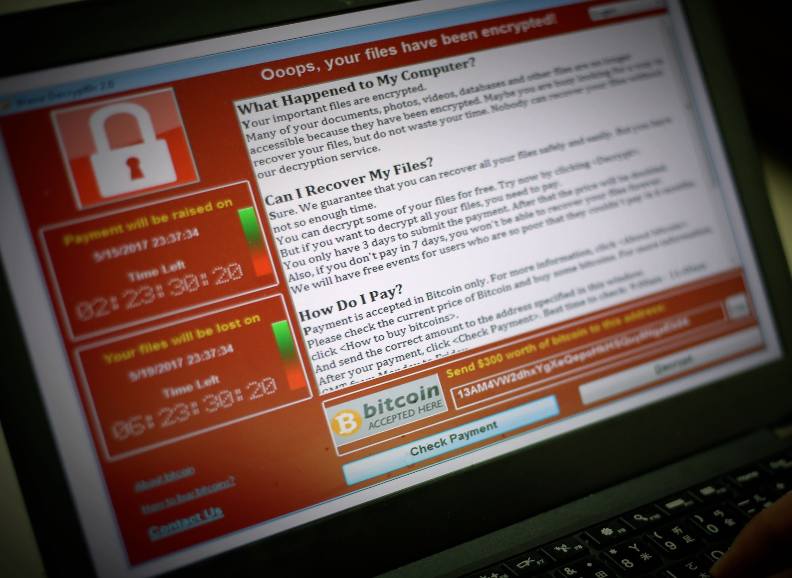
RABBIT HOLE #2: WANNACRY
Notes:
MAY 12, 2017
WANACRYPT (AKA WANNACRY)
USED EXPLOIT ETERNALBLUE
[ NEXT ]
RANSOMWARE, BUT IT DID NOT CONTAIN DECRYPTION ROUTINES, SO PEOPLE STARTED PAYING THE RANSOM WHITOUT GETTING IN RETURN THE DECRYPTION KEY
STOPPED WITH KILL SWITCH
230.000 COMPUTERS INFECTED IN 150 COUNTRIES FOR A TOTAL 140.000 DOLLARS IN BITCOIN
EARLY VERSIONS OF WANNACRY DID NOT USE ETERNALBLUE AND WAS NOT EFFECTIVE AT ALL. BUT 3 DAYS AFTER RISK SENSE PUBLISHED A BLOG POST ON HOW TO WEAPONIZE ETERNALBLUE (BASED ON THESHADOWBROKERS LEAK, BASED ON NSA), WANNACRY WAS WEAPONIZED WITH ETERNALBLUE AND IT BECAME HIGHLY EFFECTIVE.
NORTH KOREAN GOVERNMENT (BUREAU 121 OR LAZARUS GROUP) ALSO RESPONSIBLE FOR:
WANNACRY (CYBERCRIME)
BANGLADESH BANK CYBER HEIST (CYBERCRIME)
CYBER ATTACK ON SONY PICTURES (RELATED TO THE MOVIE “THE INTERVIEW”, A POLITICAL SATIRE ACTION BLACK COMEDY FILM, WHERE AMERICAN JOURNALISTS ARE RECRUITED BY THE CIA TO ASSASSINATE NORTH KOREAN LEADER KIM JONG-UN) (HACKTIVISM)
NATION STATE HACKING TARGETING THE US (ESPIONAGE)

Slide 22


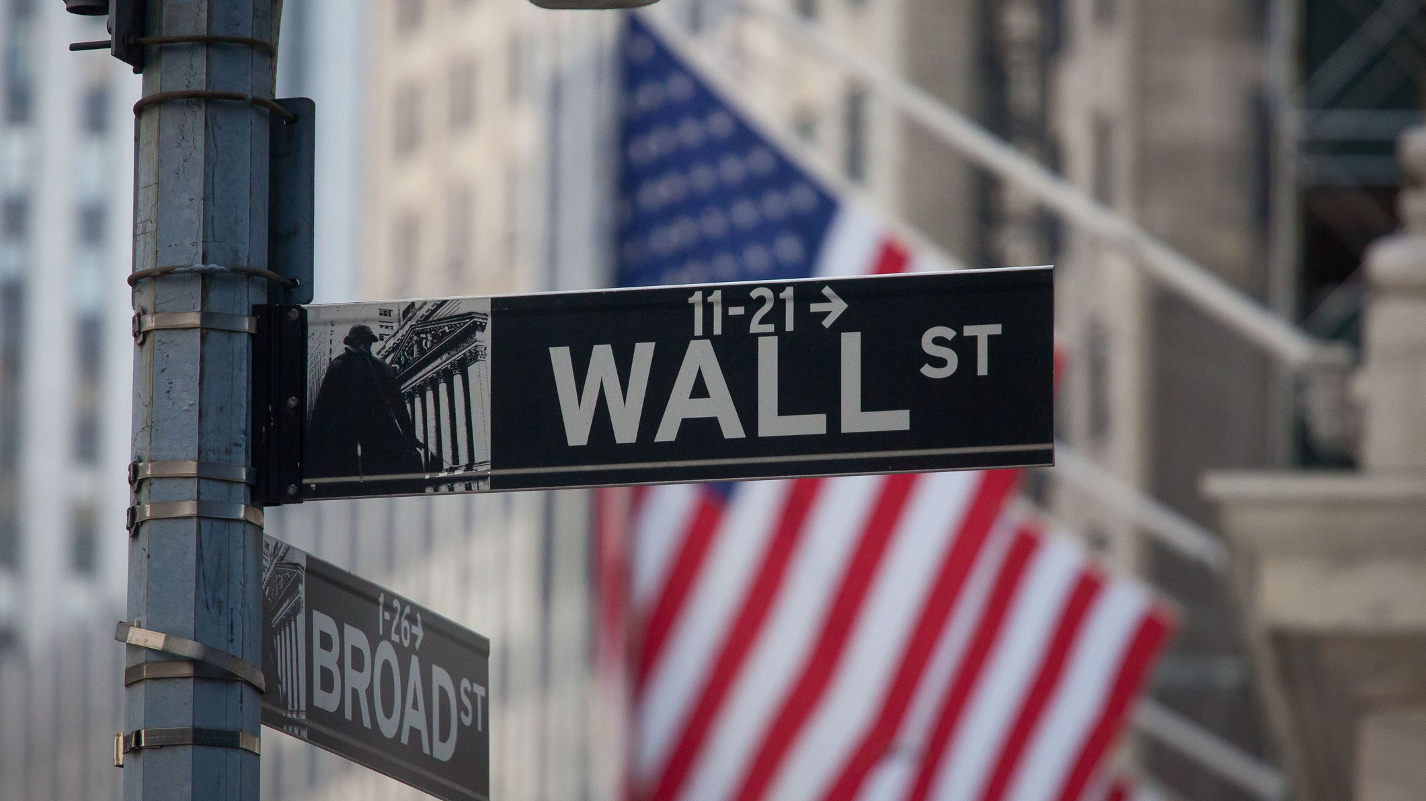
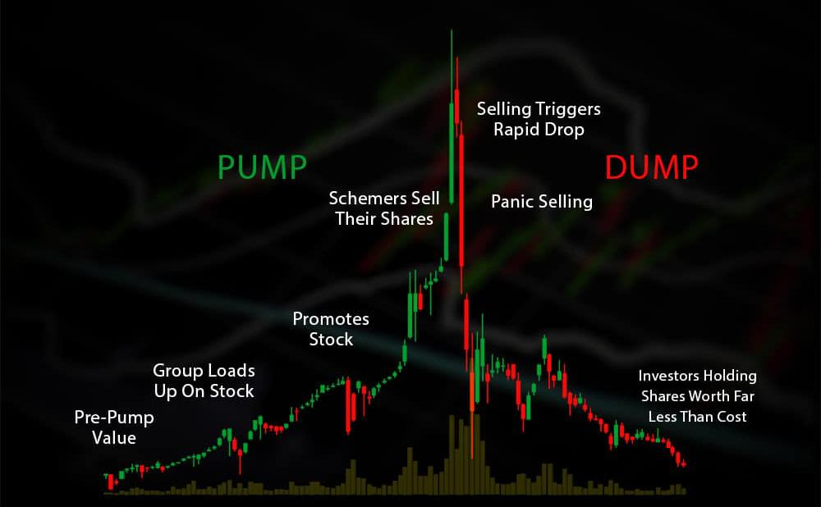
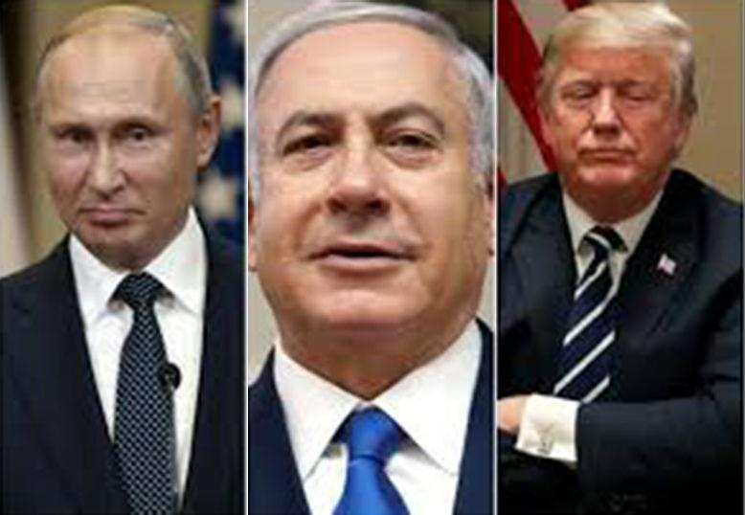
BONUS RABBIT HOLE
Notes:
OH, THIS IS A GOOD ONE :)
2014-2016
CODENAME “OPERATION RIO”
2 GREEDY CRIMINAL ISRAELI BUSINESSMEN GARY AND ZIV (CYBER CRIMINAL ACTORS) AND A HIGHLY SKILLED ISLRAELI HACKER JOSHUA (AT THE TIME OF GARY AND ZIV”S ARREST, JOSHUA WAS IN RUSSIA)
13 FINANCIAL INSTITUTIONS COMPROMISED (JP MORGAN CHASE, ADP, CITY GROUP, FIDELITY INVESTMENTS, ...)
NOT TO STEAL MONEY, BUT EMAIL ADDRESSES OF BANK CUSTOMERS, LIKELY INVESTORS
THIS IS MIND BOGGLING PER SE, JP MORGAN CHASE HAS A CYBER SECURITY ANNUAL BUDGET OF 250 MILLION DOLLARS!
PUMP-AND-DUMP SCAMS (REMEMBER THE WOLVES OF WALL STREET?) A KIND OF STOCK MARKET MANIPULATION
GARY AND ZIV ARRESTED BY FBI IN ISRAEL, JOSHUA TURNED HIMSELF IN TO FBI AFTER BEING ARRESTED BY RUSSIAN IMMIGRATION POLICE FOR BREAKING THE IMMIGRATION LAW AND NOT FLYING OUT OF RUSSIA EVERY 6 MONTHS TO MAINTAIN HIS VISA (JOSHUA WENT FROM ISRAEL TO RUSSIA TO HIDE FROM FBI)
BUT WHEN RUSSIANS KNEW FBI WAS INTERESTED IN JOSHUA, RUSSIA OFFERED JOSHUA ASYLUM IN ORDER TO HAVE SOME POLITICAL/DIPLOMATIC LEVERAGE AGAINST US AND THIS WAS DECEMBER 2016 (REMEMBER WHAT HAPPENED AROUND THAT DATE? TRUMP GOT ELECTED WITH HUGE RUSSIAN INTERFERENCE)
IN THE END JOSHUA LEFT RUSSIA AND TURNED HIMSELF IN TO THE FBI
THEN, FBI OFFERED GARY A DEAL TO DROP ALL THE CHARGES AGAINST HIM IN EXCHANGE OF A PAYMENT OF 403 MILLION DOLLARS FROM GARY’S EMPIRE AND OF GARY GOING BACK TO ISRAEL AND BECOME AN FBI?CIA INFORMANT...

Slide 23
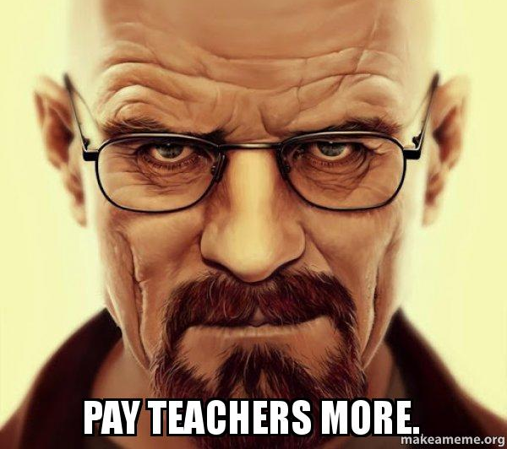
MORAL OF THE STORY?
Notes:
SO, STEFANO, WHAT IS THE MORAL OF THE STORY - YOU ARE PROBABLY ASKING - , WHAT ARE YOU TRYING TO SAY WITH THIS?
WELL…
[ CLICK NEXT ]
DO YOU REMEMBER MAERSK AND WHAT MAERSK HAD TO DO WITH THE REAL MOTIVE OF NOTPETYA’S CREATORS? -> NOTHING
AND DO YOU REMEMBER JP MORGAN CHASE AND THAT THEY WERE HACKED NOT TO STEAL THEIR PRIMARY ASSET (MONEY), BUT THEIR CUSTOMER’S EMAIL ADDRESSES?
SO VIRTUALLY ANYONE, ANY PRIVATE, PUBLIC, GOVERNMENT ORGANIZATION COULD POTENTIALLY BE HIT BY SIMILAR KIND OF NATION STATE SPONSORED ACTORS OR ORGANIZED CYBER CRIMINAL ACTIVITIES TOO, INCLUDING YOU, EVEN BY ACCIDENT, EVEN IF WE ARE NOT A HIGH PROFILE TARGET ORGANIZATION
THE VERY FIRST STEP TOWARDS SOLVING A PROBLEM IS TO RECOGNIZE THAT WE HAVE A PROBLEM IN FIRST PLACE

Slide 24

APPRECIATE YOUR TIME
Notes:
AND WITH THAT, PLEASE FEEL FREE TO ASK ME ANY QUESTION YOU MAY HAVE NOW
OR OFFLINE AT ANY TIME VIA EMAIL, SLACK OR GOOGLE MEET
THANKS!

Slide 25
RESOURCES
THESE SLIDES………......................................................https://drive.google.com/
MITRE ATT&CK……………………………………………………………..https://attack.mitre.org/
THE C2 MATRIX…………………………………………………………….https://www.thec2matrix.com/
CALDERA………………………………………………………………………..https://github.com/mitre/caldera
VECTR……………………………………………………………………………..https://vectr.io/
ATOMIC RED TEAM……………………………………………………….https://atomicredteam.io/
ATT&CK PLAY AT HOME EDITION……………………………...http://y2u.be/wlJElPA0xqY
MORE ON THE BAD GUYS…………………………………………...https://attack.mitre.org/groups/
MORE ON NOTPETYA…………………………………………………..https://attack.mitre.org/software/S0368/
MORE ON WANNACRY………………………………………………...https://attack.mitre.org/software/S0366/
KNAVES OUT, DARKNET DIARIES……………………………….https://darknetdiaries.com/episode/76/
Notes:
HERE IS WHERE I PUT TOGETHER SOME OF THE LINKS TO TOOLS AND STORIES I MENTIONED

Slide 26



THANK YOU
STEFANO.RATTO@GMAIL.COM
@STEFANO_RATTO
@STEFANORATTO
Notes:
AND FINALLY, I’D LIKE TO TAKE A MOMENT AND THANK BLABLA AND BLABLABLA FOR BLABLABLABLA AND BLABLABLABLABLA FOR BLABLABLABLABLABLABLA.
THANKS AGAIN AND FEEL FREE TO ASK ME ANY QUESTION.
OTHERWISE, THAT’S ALL, THANK YOU!

